Slide 1
Creating healthy academic habits
Webinar 5 – Stress reduction habits
Facilitated by: Ashley Harwood, lmsw (Counseling & Wellness Services)

Slide 2
habits that we’ll cover in this webinar series:
Time Management
Goal Setting
Self Care
Mindfulness
Stress Reduction (This week!)
Combating Perfectionism
Building Positive Self Talk

Slide 3
Habit 1: Develop your own Stress & Anxiety Toolkit
Most everybody experiences stress and anxiety to varying degrees. Each individual carries resources and knowledge to manage day-to-day experiences. These resources and knowledge have been shaped on the individual level by family, friends, mentors, and on a community level via culture, environments, and by the various systems which an individual interacts.
There are countless resources and practices that humans engage in to manage everyday stress and anxiety. This toolkit recognizes that each participant carries their own forms of knowledge and are the experts of their own lives.
In this webinar, students can take an inventory of their own existing personal toolkit, as well as, further cultivate their toolkit with new practices.
*Adapted from https://healthy.ucla.edu/wp-content/uploads/2020/08/Stress-Anxiety-Toolkit.pdf

Slide 4
Habit 2: utilize Empowerment approach
Strengths-based
Arts and healing-informed
Trauma-informed
Focused on nurturing and celebrating resilience
*Adapted from https://healthy.ucla.edu/wp-content/uploads/2020/08/Stress-Anxiety-Toolkit.pdf

Slide 5
Habit 3: build self awareness
Build one’s own self awareness of their stress and anxiety
Take a full inventory
Where does the stress and anxiety live in your body?
What triggers the stress/anxiety? (i.e. what’s the stressors?)
How do you currently cope with the stress and anxiety?
Are there more adaptive/healthier coping strategies you could implement? (We’ll explore some ideas today!)
*Adapted from https://healthy.ucla.edu/wp-content/uploads/2020/08/Stress-Anxiety-Toolkit.pdf

Slide 6
Habit 3: build self awareness (cont.)
Take a Stress Assessment:
Understand yourself and your characteristic style (Individual differences)
Personality/temperament
Stress-reducing, stress-enhancing behavior
Identify sources of stress in your life (Stress Exposure)
Daily hassles, major life events
“Internal” stress exposure: worry or rumination
Characterize your tendencies for stress reactivity
Consider physiological, emotional, and cognitive levels
How are you able to recover and restore during and after experiencing stressful events?
End-of-day cognitive and physiological levels
Sleep assessments and diary
What is your profile with respect to stress buffers
Health behavior, positive experiences, social supports
*Adapted from https://gradschool.utah.edu/_resources/documents/stress-management_graduate-school_11-1-18.pdf

Slide 7
Definitions:
Anxiety: an alarm system that alerts us that something is threatening or amiss. It becomes a mental health concern when the alarm system is not working properly, when it is ringing all the time in response to nothing or minor concerns, or it is blaring over something that should be manageable.
Stress: in its manageable forms, is any experience of change, anything that requires adaptation, stress comes with change (positive and negative).
Stress & Anxiety can be capacity building: This means that when people go through a difficult experience, the upshot is that they are potentially more durable because the experience has expanded their capacities for dealing with difficulty.
Resources: What resources does a person have on-hand to manage day-to-day stress and anxiety and not feel overwhelmed by it?
Recovery: Healthy functioning and sustainability are directly tied to RECOVERY. It’s all about recovery. Consider lifting weights. You can’t lift nonstop without major injury. You have to have periods of rest and recovery.
*Adapted from https://healthy.ucla.edu/wp-content/uploads/2020/08/Stress-Anxiety-Toolkit.pdf

Slide 8
Common misconceptions
There seem to be some misconceptions in United States pop culture about stress and anxiety.
We seem to look at every variety of stress and anxiety and see it as pathological and “BAD”.
However, anxiety up to a point is a totally normal and protective function.
Stress up to a point is a totally healthy and productive function.
Both stress and anxiety can be viewed as developmental processes. They mean we are striving for something, working towards a goals, putting ourself out there and being courageous!
No distinction is being made between a really anxious moment and pathological anxiety. And this may be creating way more stress and anxiety than is necessary and depleting our ability to recognize our own wisdom and resilience to manage day-to-day stress and anxiety.
So much of the stress and anxiety that happens in the day-to-day falls into the manageable range, but many are forgetting that they have capacity and knowledge to manage it.
*Adapted from https://healthy.ucla.edu/wp-content/uploads/2020/08/Stress-Anxiety-Toolkit.pdf

Slide 9
Not all stress is bad: Eustress vs distress
Eustress and distress are terms that categorize different types of stress. At one end of the spectrum is distress, which involves negative feelings and is often a difficult experience. At the other end is eustress, which is challenging but rewarding.
People can experience eustress when they feel confident in their ability to solve a problem or cope with a situation. For example, they may feel stressed about an exam but know that they have prepared enough to be able to do it. Afterward, they may feel a sense of accomplishment or pride.
In comparison, distress can occur when a person feels unable to cope or out of their depth. For example, if a person has not studied for an upcoming exam, they may feel anxious or panicked.
However, distress is not inherently damaging. In some cases, people who initially feel distressed in a situation may become motivated to address a problem, leading to better outcomes in the future. Their experience of the stress may also change over time.
*Adapted from https://www.medicalnewstoday.com/articles/eustress-vs-distress#definitions

Slide 10
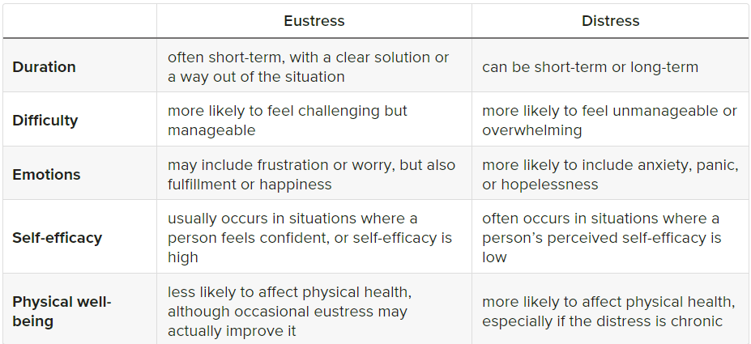
Eustress vs distress (Cont.)
*Adapted from https://www.medicalnewstoday.com/articles/eustress-vs-distress#definitions

Slide 11
Goal of the toolkit
Life is often full of conditions that make individuals feel like they are “lifting weights” for extended periods of time (i.e. grad school can certainly feel like this at times!).
It is important to think through our day-to-day expectations and make sure there are opportunities for rest and recovery (individually and collectively).
It may be helpful to keep in mind 3 categories for stressors:
Things we like
Things we can handle
Things that are crisis
Building up your individual toolkit can help you get more in touch with when and how stress and anxiety are showing up, and raising awareness about your own need for recovery. Ultimately, the goal of the toolkit is to help you handle more things and not plunge into crisis.
*Adapted from https://healthy.ucla.edu/wp-content/uploads/2020/08/Stress-Anxiety-Toolkit.pdf

Slide 12
Habit 4: add practices to your toolkit (examples)
Play (open-ended free play, structured play such as games, organized play such as sports)
Mindfulness techniques (meditation, breathing techniques)
Physical/Somatic Practices (yoga, tai chi, martial arts, dance)
Cognitive/Thought Practices (watching one’s thoughts, re-framing negative thoughts, mantras, affirmations)
Time in Nature (relaxing, playing, simply being)
Supportive Relationships
Social Engagement/Connectedness (clubs, religious or community gatherings, volunteering)
Time Management (breaks, micro-breaks, unplugging)
Gratitude and Awe Practices
Self-Care and Self-Love (sleep hygiene, nutrition, exercise, supportive self talk, etc.)
Built Environment (intentionally creating supportive spaces with lighting, comfortable furniture, aromatherapy, plants, etc.)
Spirituality
Music (listening and/or playing)
Arts (witnessing and/or participating)
And so much more…
*Adapted from https://healthy.ucla.edu/wp-content/uploads/2020/08/Stress-Anxiety-Toolkit.pdf

Slide 13
Habit 5: Journal worries & Alternative thoughts (specific example)
Take a piece of paper and create two columns. Label one column “worries” and the other “alternative thoughts” or “thought reframes”.
For example, “I am too busy to meditate” and as an alternative “I am handling a lot right now, but my mind could recover and gain more focus if I meditated for 5 minutes twice a week”. Or, “I dislike my body” and as an alternative “I have a body that serves me every day, I wonder how I could take better care of my body?”.
*Adapted from https://healthy.ucla.edu/wp-content/uploads/2020/08/Stress-Anxiety-Toolkit.pdf

Slide 14
Reminder to: utilize CUNY SPH Counseling & wellness services or mental health resources in your community
NOTE: Stress reducing habits should not replace medications or other therapies prescribed by your health care or mental health care provider. If you are experiencing depression, anxiety, or other mental distress, see your provider right away.
SPH Counseling & Wellness:
Free counseling support for students living in NY state. We can offer referrals for students out of state.
https://sph.cuny.edu/students/student-services/student-wellness/counseling-and-wellness-services/
Mental Health Resources:
For free 24/7 support or referrals there is CUNY Crisis, NYC WELL or the national 988 mental health hotline (info below)
Crisis Text Line: Text CUNY to 741741 for crisis counseling
NYC WELL: Text WELL to 65173; Chat: https://nycwell.cityofnewyork.us/en/; Call 1-888-NYC-WELL (1-888-692-9355)
988: Text to 988; Chat: https://988lifeline.org/chat/; Call 988
For outside providers:
Search providers through your health insurance website
Psychology Today: https://www.psychologytoday.com/
Open Path Collective: https://openpathcollective.org/
Telehealth clinics: Mindful Care https://www.mindful.care and Lifestance Health https://lifestance.com/

Slide 15
Reminder to: Practice positive affirmations ☺
“I am smart and capable of achieving success”
“I am loved and supported by my family and friends”
“I have the ability to work hard and follow through with tasks”
“I’m responsible for how I react to situations”
“I can get through anything with determination and focus”
“I have a positive attitude even when faced with challenges”
“It’s ok to express my emotions in healthy ways”

